Slide 1
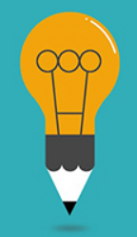
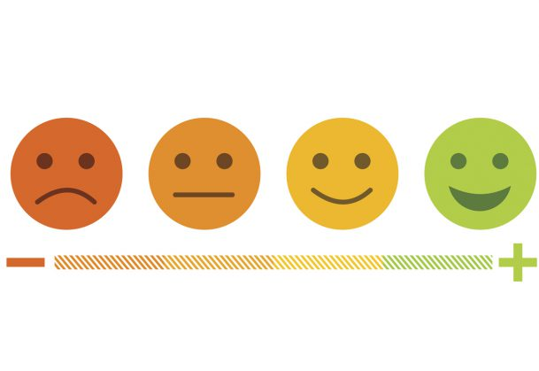
Knowing Your Twitter Sentiment
M.H.Saboo Siddik Polytechnic , Mumbai
Ansari Nusrat
Kasali Heena
Khan Iqra

Slide 2
Content
Introduction
Implementation
Advantages
Limitation
Applications
Future Scope
Conclusion
References

Slide 3




Introduction
What

Slide 4

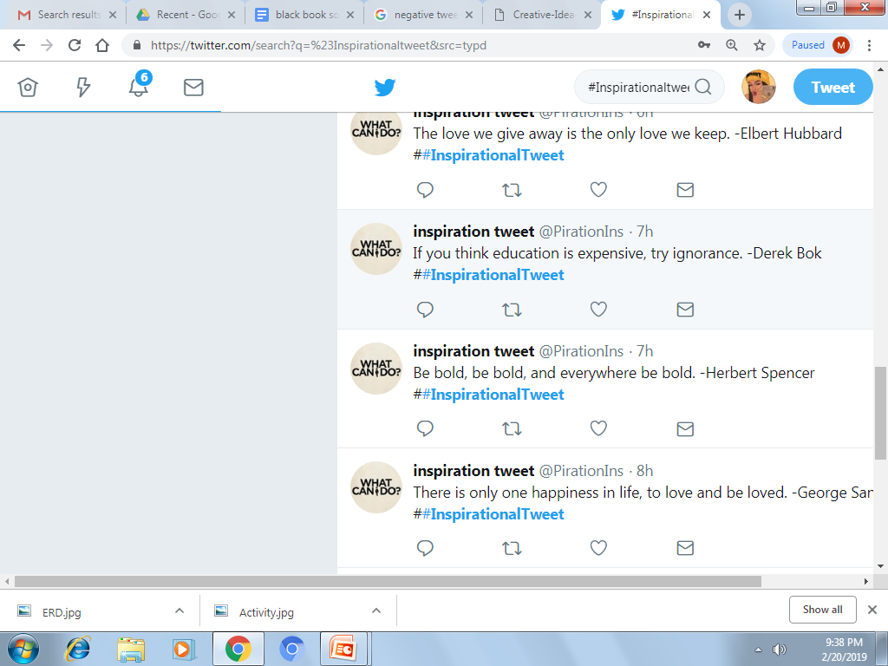
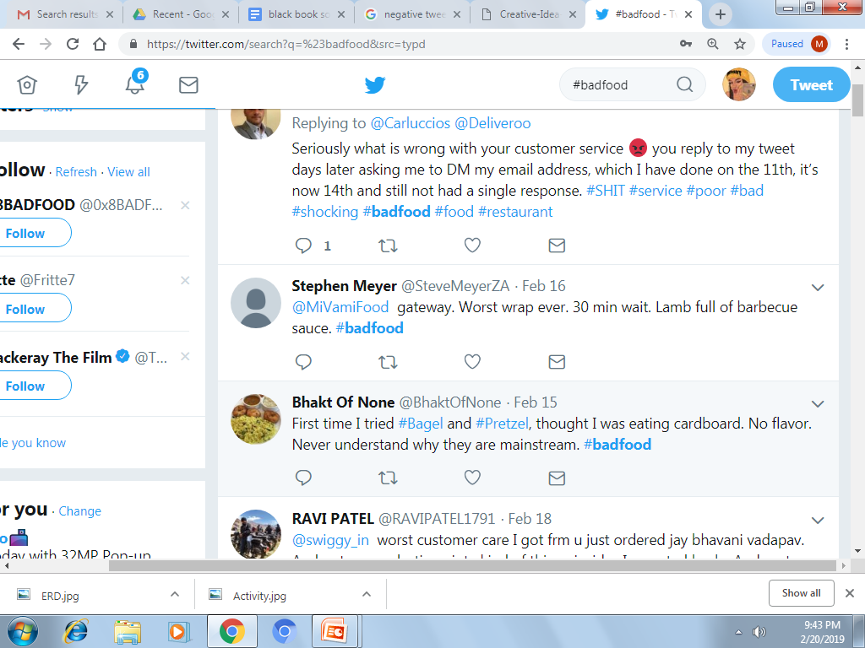
Example
I
+3
-1
NO FLAVOR

Slide 5



Implementation
Database
Tweets
Remove HTML Tag
HTML
POS Tagging
Sentiment
Result
Naïve Bayes Classifier
Feature
Extraction

Slide 6
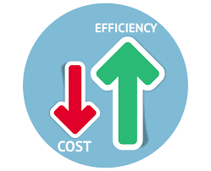
Advantages
Get to know what’s trending.
A lower cost than traditional
methods of getting customer
Insights.

Slide 7

Ability to detect sarcasm
Faster
Faster way to get opinions of others

Slide 8
Can work with emojis.

Slide 9


limitations
Takes time to work on REAL TIME SYSTEM because of large data set
Only works on 3 languages like HINDI ,ENGLISH ,and Hin-glish (combination Of English And Hindi )

Slide 10
references
https://www.academia.edu/people/search?utf8=%E2%9C%93&amp;q=sentiment+analysis+of+twitter+data+using+machine+learning
https://blog.hubspot.com/marketing/best-hashtags-twitter
https://arxiv.org/ftp/arxiv/papers/1711/1711.10377.pdf
https://www.irjet.net/archives/V5/i5/IRJET-V5I5550.pdf
https://www.youtube.com/watch?v=eFdPGpny_hY
https://arxiv.org/ftp/arxiv/papers/1509/1509.04219.pdf
http://creativepr.com/problem-sentiment-analysis/

